Slide 1

SUB NET MASK (Task 1)

Slide 2
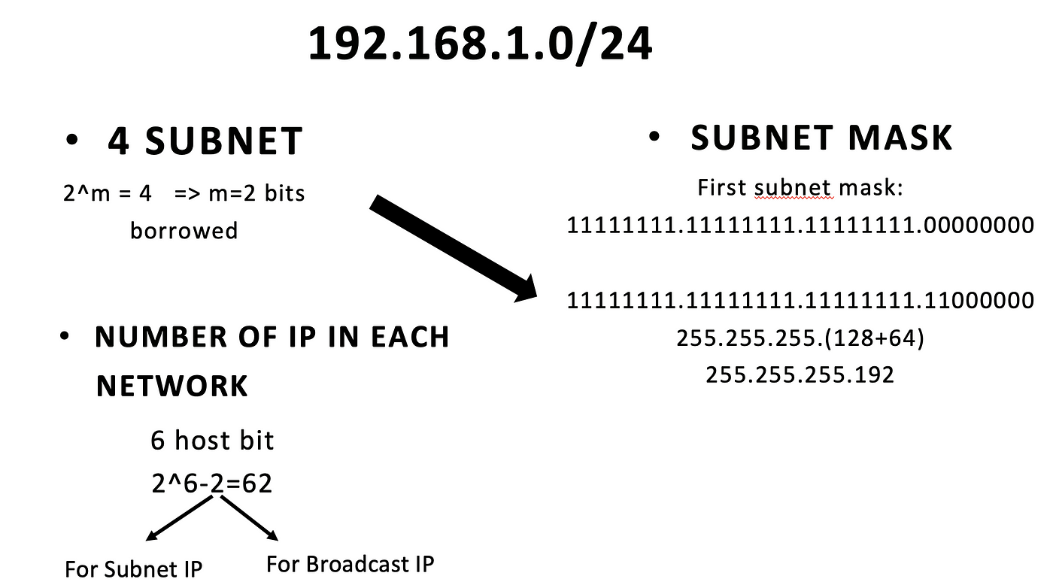
Minimum Subnet mask

Slide 3
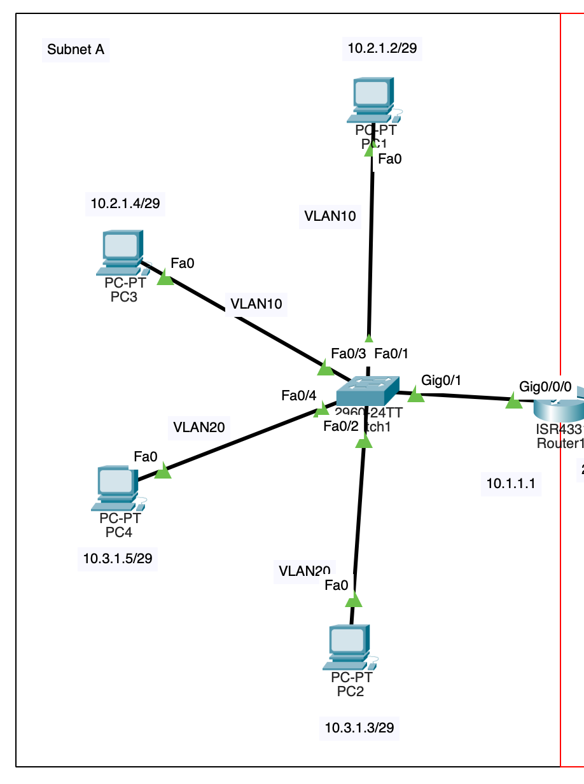
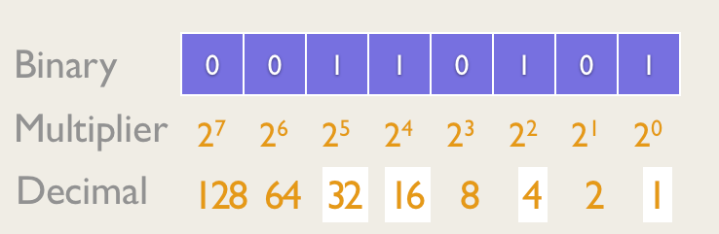
Minimum Subnet mask
6 DEVICES

Slide 4
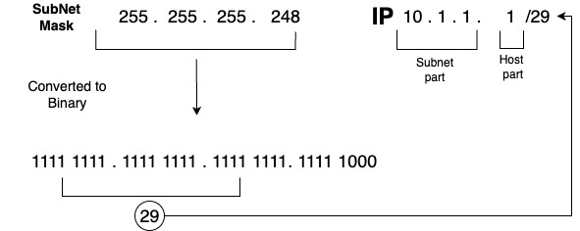
IP address structure.

Slide 5
Router throwing out segment for difference subnet.
When a router discards a segment intended for a different subnet, it's essentially enforcing network segmentation.
Network segmentation is a security practice that divides a network into smaller, isolated segments or subnets to enhance security, manage traffic, and optimize performance.
For legitimate communication between subnets, routers can be configured with routing rules or access control lists (ACLs) to permit specific traffic while still maintaining segmentation.

Slide 6
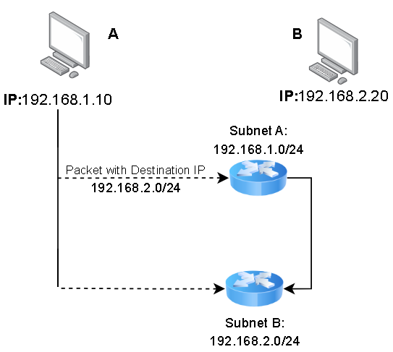
Router throwing out segment for difference subnet.

Slide 7
Router connect devices within same subnet.
When a router connects devices within the same subnet, it's typically acting as a bridge or switch rather than a traditional router.
In networking, routers are primarily responsible for forwarding packets between different networks or subnets.
However, in scenarios where a router connects devices within the same subnet, it essentially functions as a layer 3 switch or a gateway for local traffic.

Slide 8
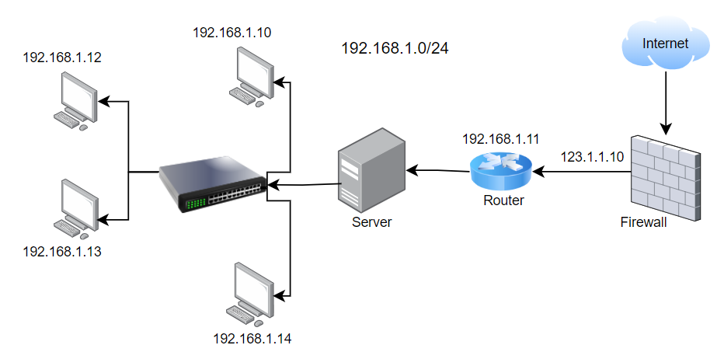
Router connect devices within same subnet.

Slide 9
Virtual Local Area Networks (VLAN) (Task 2)

Slide 10
What is use of VLAN ?
VLANs (Virtual Local Area Networks) are used to segment a network into smaller, isolated networks, improving security, reducing broadcast traffic, and increasing network performance by controlling broadcast domains.
They also facilitate better organization, management, and scalability within a network infrastructure.

Slide 11
What is use of VLAN ?
Security:
VLANs provide network segmentation, allowing you to isolate sensitive or critical systems from other parts of the network. This isolation helps prevent unauthorized access and limits the scope of security breaches.
Performance:
By dividing the network into smaller broadcast domains, VLANs reduce the amount of broadcast traffic and increase network efficiency. This can lead to better performance, especially in larger networks.
Flexibility:
VLANs allow you to logically group devices based on factors such as department, function, or location, rather than physical location. This flexibility makes it easier to manage and reconfigure the network as needed.
Cost Savings:
VLANs can help reduce the need for additional physical infrastructure by allowing multiple virtual networks to share the same physical network infrastructure. This can lead to cost savings in terms of equipment and maintenance.
Quality of Service (QoS):
VLANs can be used to prioritize network traffic based on the type of data being transmitted. This helps ensure that critical applications receive the necessary bandwidth and network resources to function properly.

Slide 12
Address Resolution Protocol (ARP) (Task 3)

Slide 13
What’s an ARP?
The Address Resolution Protocol (ARP) is a communication protocol used for mapping an IP address to a physical machine address, like a MAC address.
When a device wants to communicate with another device on the same network, it uses ARP to discover the MAC address associated with the IP address of the target device.

Slide 14
What does ARP do?
Mapping IP addresses to MAC addresses: When a device on a network needs to communicate with another device, it uses ARP to find the MAC address associated with the IP address of the target device.
Maintaining a cache of mappings: ARP maintains a cache, known as the ARP cache or ARP table, which stores the mappings of IP addresses to MAC addresses. This cache helps in reducing the need for ARP requests for frequently accessed devices.

Slide 15
How does it work ?
ARP Request: When a device wants to communicate with another device on the same network and it knows the IP address of the target device but not its MAC address, it broadcasts an ARP request packet to the entire network. The request contains the IP address of the target device.
ARP Reply: The device with the matching IP address responds with an ARP reply packet containing its MAC address. This reply is usually unicast, sent directly to the requesting device.
Caching: Once the requesting device receives the ARP reply, it updates its ARP cache with the mapping of the IP address to the MAC address. This helps in future communication, as the device can now directly use the MAC address from its cache without needing to send ARP requests again for that specific IP address.

Slide 16
What is ARP? | NetworkAcademy.io

Slide 17
What is ARP in Networking Useful For?
Mapping IP addresses to MAC addresses: ARP allows devices on a network to determine the MAC address associated with a specific IP address. This mapping is essential for data transmission at the link layer (Layer 2) of the OSI model.
Local network communication: ARP enables devices to communicate with each other within the same local network segment. By resolving IP addresses to MAC addresses, devices can exchange data packets efficiently.
Efficient data transmission: ARP helps optimize data transmission by ensuring that data packets are delivered to the correct destination device. By using MAC addresses, devices can directly communicate at the link layer without involving higher-layer protocols.
Dynamic network configuration: ARP supports dynamic network configuration by updating ARP caches with mappings of IP addresses to MAC addresses. This dynamic mapping allows devices to communicate with each other even if their IP addresses change over time.

